Slide 1
Inheritance
“the mechanism by which one class acquires
the properties of another class”
CS 308 – Data Structures

Slide 2
Arrange concepts into an inheritance hierarchy
Concepts at higher levels are more general
Concepts at lower levels are more specific (inherit properties of concepts at higher levels)
Vehicle
Wheeled vehicle
Boat
Car
Bicycle
2-door
4-door

Slide 3
C++ and inheritance
The language mechanism by which one class acquires the properties (data and operations) of another class
Base Class (or superclass): the class being inherited from
Derived Class (or subclass): the class that inherits

Slide 4
Advantages of inheritance
When a class inherits from another class, there are three benefits:
(1) You can reuse the methods and data of the existing class
(2) You can extend the existing class by adding new data and new methods
(3) You can modify the existing class by overloading its methods with your own implementations

Slide 5
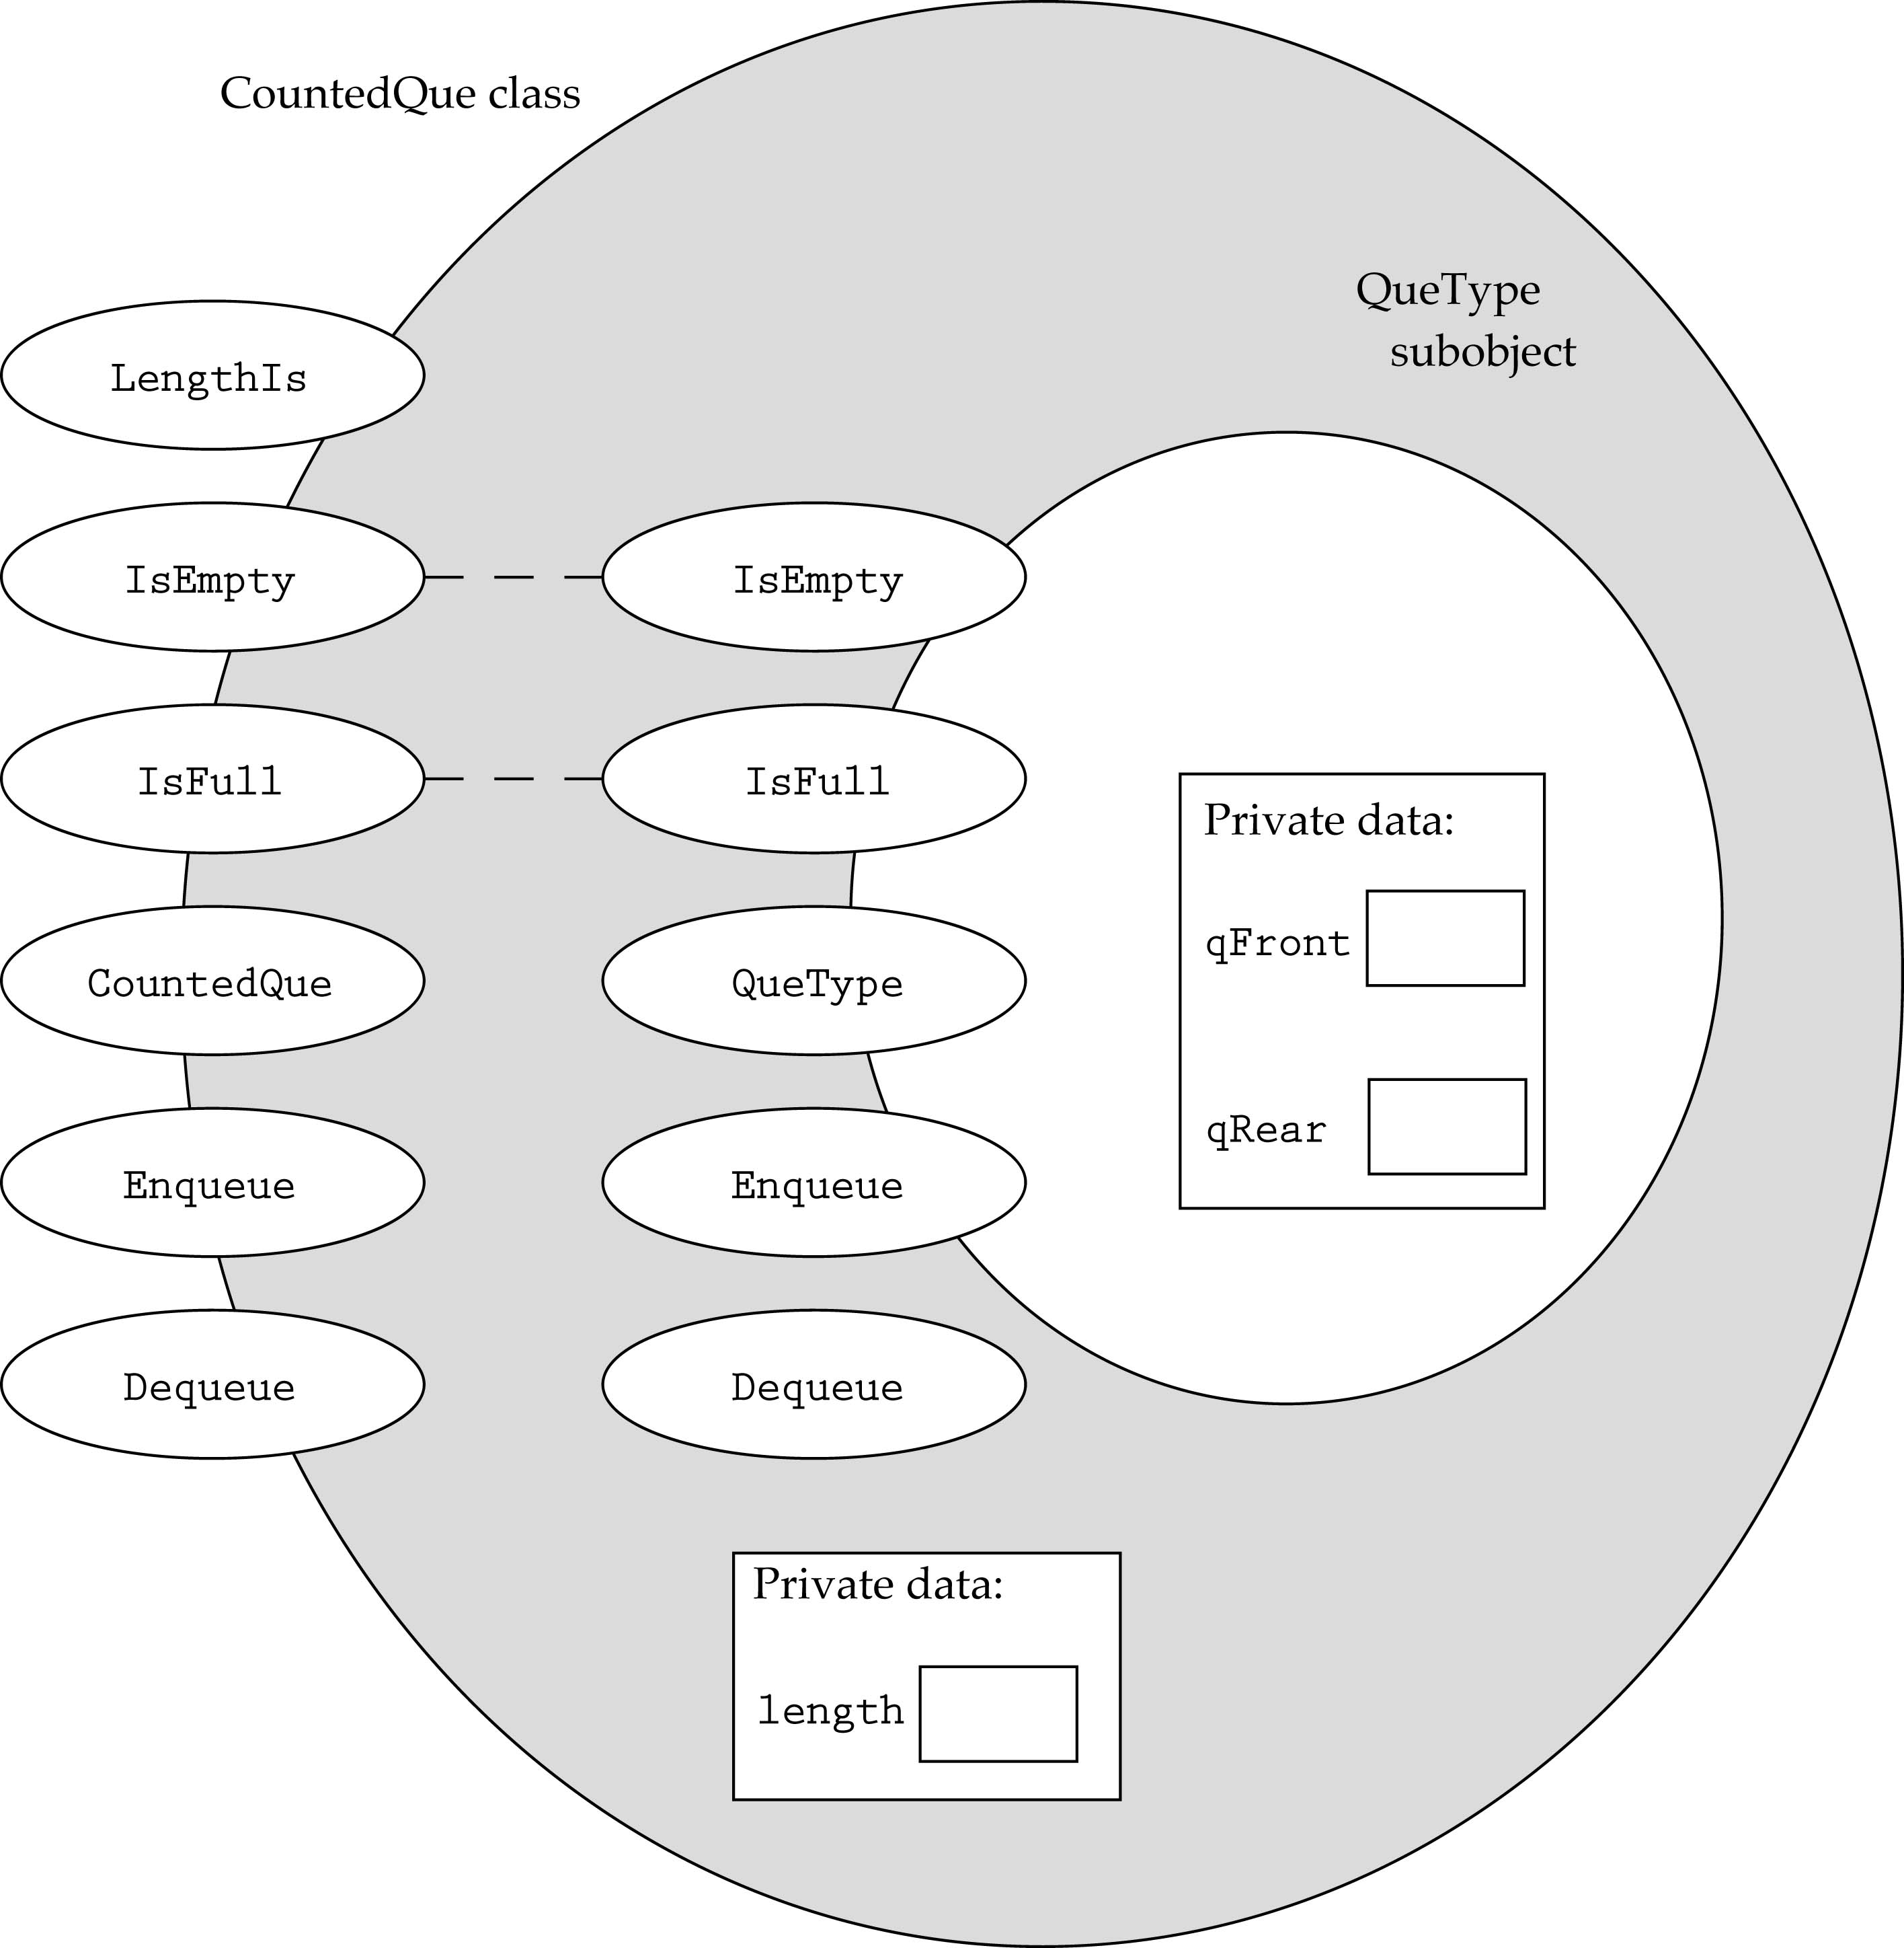
Deriving One Class from Another

Slide 6
Deriving One Class from Another (cont’d)
Define a new class CountedQue from QueType such that it has a new data member (length) that records the number of items in the queue
  template<class ItemType>
  class CountedQue : public QueType<ItemType> {
  public:
  CountedQue();
  void Enqueue (ItemType newItem);
  void Dequeue (ItemType& item);
  int LengthIs() const;
  private:
  int length;
  };

Slide 7
Inheritance and accessibility
A class inherits the behavior of another class and enhances it in some way
Inheritance does not mean inheriting access to another class’ private members

Slide 8
Rules for building a class hierarchy
Derived classes are special cases of base classes
A derived class can also serve as a base class for new classes.
There is no limit on the depth of inheritance allowed in C++ (as far as it is within the limits of your compiler)
It is possible for a class to be a base class for more than one derived class

Slide 9
Modifying class behavior
template<class ItemType>
void CountedQue<ItemType>::Enqueue(ItemType newItem)
{
length++;
QueType<ItemType>::Enqueue(newItem);
}
template<class ItemType>
void CountedQue<ItemType>::Dequeue(ItemType& item)
{
length--;
QueType<ItemType>::Dequeue(item);
}
template<class ItemType>
int CountedQue<ItemType>::LengthIs() const
{
return length;
}
// class constructor
template<class ItemType>
CountedQue<ItemType>::CountedQue() : QueType<ItemType>()
{
length=0;
}

Slide 10
Polymorphism
Any code you write to manipulate a base class will also work with any class derived from the base class.
C++ general rule for passing objects to a function:
“the actual parameters and their corresponding formal parameters must be of the same type”
With inheritance, C++ relaxes this rule:
  “the type of the actual parameter can be a class derived from the class of the formal parameter”

Slide 11
An example
template<class ItemType>
void Test(QueType& q, ItemType item)
{
q.Enqueue(item);
....
}
Any object of a class derived from QueType can be passed to the function !!
Which Enqueue() function should be used? (the compiler does not know that at compile time)

Slide 12
Static vs. dynamic binding
Static Binding: the determination of which method to call at compile time
Dynamic Binding: the determination of which method to call at run time

Slide 13
Virtual Functions
C++ uses virtual functions to implement run-time binding.
To force the compiler to generate code that guarantees dynamic binding, the word virtual should appear before the function declaration in the definition of the base class.

Slide 14
Queue Implementation
template<class ItemType>
class QueueType {
public:
QueueType(int);
QueueType();
~QueueType();
void MakeEmpty();
bool IsEmpty() const;
bool IsFull() const;
virtual void Enqueue(ItemType);
virtual void Dequeue(ItemType&);
private:
int front;
int rear;
ItemType* items;
int maxQue;
};

Slide 15
Virtual Functions (cont.)
Rules for static/dynamic binding:
  If the member function of the base class is not a virtual function, the type of the formal parameter determines which function to call.
  If the member function of the base class is a virtual function, the type of the actual parameter determines which function to call.

Slide 16
An example
class ItemType {
public:
...
virtual bool operator<(ItemType) const;
private: protected:
StrType lastName;
};
bool ItemType::operator<(ItemType item) const
{
int result;
result = strcmp(lastName, item.lastName);
if(result < 0)
return true;
else
return false;
}

Slide 17
Let's derive a new class from it:
class NewItemType : public ItemType {
public:
...
bool operator<(NewItemType) const;
private:
StrType firstName;
};

Slide 18
Let's derive a new class from it: (cont.)
bool NewItemType::operator<(NewItemType item) const
{
int result;
result = strcmp(lastName, item.lastName);
if(result < 0)
return true;
else if(result > 0)
return false;
else { // same last name
result = strcmp(firstName, item.firstName);
if(result < 0)
return true;
else
return false;
}
}

Slide 19
Let's assume that the client program includes the following function:
void PrintResult(ItemType& first, ItemType& second)
{
if(first < second) // first.operator<(second)
cout << "First comes before second";
else
cout << "First does not come before second";
}

Slide 20
Let's assume that the client program executes the following code:
ItemType item1, item2;
NewItemType item3, item4;
....
PrintResult(item1, item2);
PrintResult(item3, item4);

Slide 21
Protected class members
Derived classes cannot access the private data of the base class
Declaring methods and data of the base class as protected (instead of private) allows derived classes to access them
Objects outside the class, however, cannot access them (same as private)

Slide 22
Warning: call by reference vs. call by value
If the object of the derived class is passed by reference, everything works fine.
If the object of the derived class is passed by value, only the sub-object of the base class is passed to the function (slicing problem)!!

Slide 23
Protected and Private Inheritance
Y
class X : protected Y {
...
};
With protected inheritance, public and protected members of Y become protected in X (i.e., classes derived from X inherit the public members of Y as protected)
With private inheritance, public and protected members of Y become private in X (i.e., classes derived from X inherit the public members of Y as private)
Default inheritance: private
X

Slide 24
Constructors and destructors
You cannot override a base class constructor with a derived class constructor (rather, the derived class constructor calls the base class constructor first)
All base class destructors should be declared virtual
Virtual destructors are called in reverse order from the constructors for derived class objects

Slide 25
Multiple Inheritance
Derived classes can inherit from more than one base classes
X
(base for Y)
Y
(base for Z)
Z

Slide 26
Example
Define a new class LookAheadStack that is derived from class StackType.
(1) A look-ahead stack differs from the standard stack only in the push operation.
(2) An item is added to the stack by the push method only if its different from the top stack element.

Slide 27
    template<class ItemType>
    struct NodeType;
    template<class ItemType>
    class StackType {
    public:
    StackType();
    ~StackType();
    void MakeEmpty();
    bool IsEmpty() const;
    bool IsFull() const;
    void Push (ItemType);
    void Pop(ItemType&);
    private:
    NodeType<ItemType>* topPtr;
    };

Slide 28
template<class ItemType>
class LookAheadStack : public StackType<ItemType>
{
public:
void Push(ItemType);
LookAheadStack();
~LookAheadStack();
};

Slide 29
Implement the new push function and the derived class’ constructor.

Slide 30
    template<class ItemType>
    void LookAheadStack <ItemType>::Push(ItemType newItem)
    {
    ItemType item;
    if ( !StackType<ItemType>::IsEmpty() ) {
    StackType<ItemType>::Pop(item);
    StackType<ItemType>::Push(item);
    if (item != newItem)
    StackType<ItemType>::Push(newItem);
    }
    else
    StackType<ItemType>::Push(newItem);
    }
    Constructor:
    template<class ItemType>
    LookAheadStack <ItemType>:: LookAheadStack():StackType()
    {
    }

Slide 31
Which functions and from which class should be declared as virtual?

Slide 32
The functions that should be declared as virtual are:
Push from base class (StackType)
Destructor from base class (StackType)

Slide 33
Exercises
18-21, 23

